Slide 1
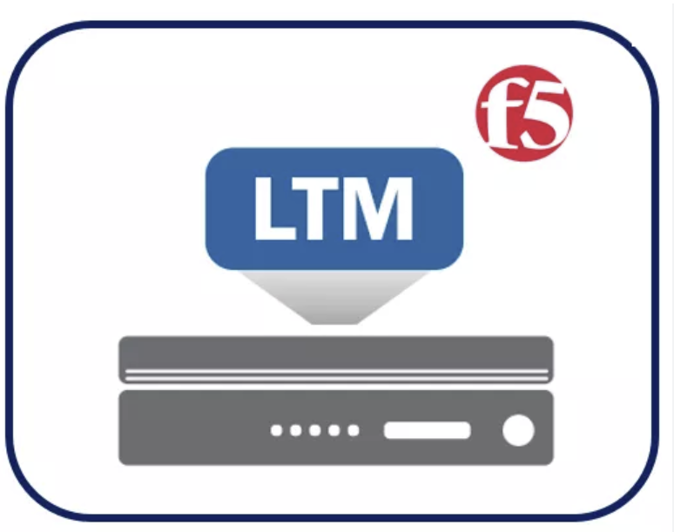

F5 LTM Learning with Alexander S

Slide 2
Agenda →
F5 LTM Learning Series
Chapter 01 – Deploy a Sample Web Application on WebSrv01 and WebSrv02
Chapter 02 – Verify that the Web Application as accessible from the Client Machine to WebSrv01 and WebSrv02
Chapter 03 – Discuss the need for a reverse proxy, focusing on load balancing and security.
Chapter 04 – Understand how the F5 LTM operates as a full reverse proxy.
Chapter 05 – Learn the concepts of Nodes, Health Monitors, Pools, and Pool Members.
Chapter 06 – Configure Nodes, Health Monitors, Pools, and Pool Members on the F5.
Chapter 07 – Explore and configure the following F5 Profiles:
TCP Profile
HTTP Profile
Cookie Persistence Profile
Source Address Persistence Profile
SNAT (Auto Map) Profile
OneConnect Profile
Compression Profile
Caching Profile
Chapter 08 – Create the Virtual Server, attaching the pool and applying the configured profiles (TCP, HTTP, Cookie Persistence, OneConnect, Compression, and Caching).
Chapter 09 – Test the application access using virtual server and monitor the connections.

Slide 3
F5 LTM Learning Series
Chapter 01 – Deploy a Sample Web Application on WebSrv01 and WebSrv02

Slide 4
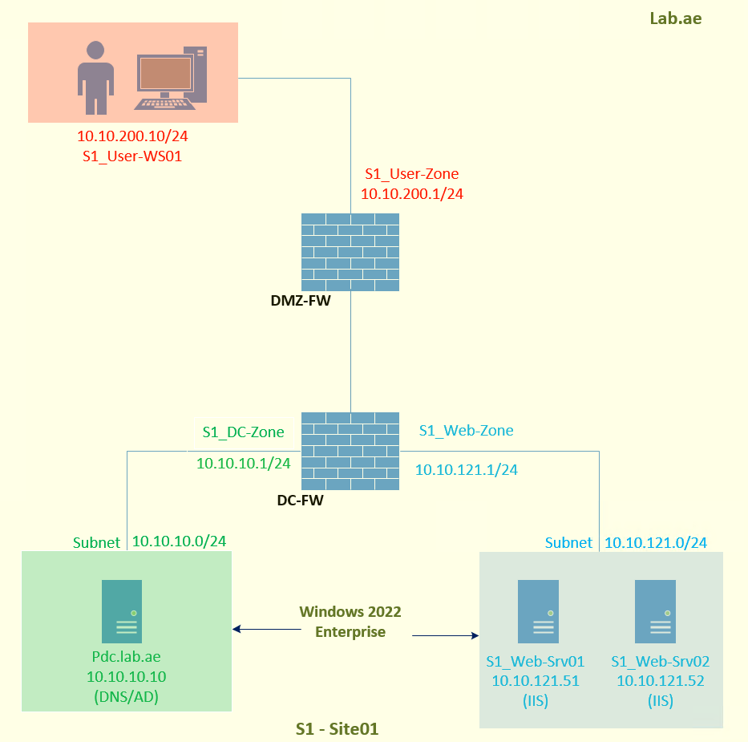
Chapter 01 - Deploy a Sample Web Application on WebSrv01 and WebSrv02
Lab Topology for LTM learning
DC-Zone : 10.10.10.0/24
GW : 10.10.10.1
PDC : 10.10.10.10
PDC Role : Active Directory & DNS
PDC OS : Windows-2022-Enterprise
Web-Zone : 10.10.121.0/24
GW : 10.10.121.1
Web-Srv01 : 10.10.121.51
Web-Srv02 : 10.10.121.52
OS : Windows-2022-Enterprise
Role : Web Hosting Server
Web Service : IIS

Slide 5
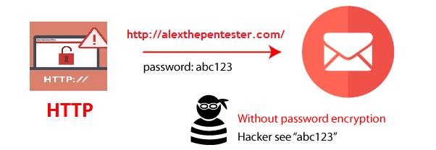
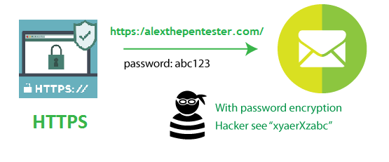
Chapter 01 - Deploy a Sample Web Application on WebSrv01 and WebSrv02
Two types of publishing (HTTP & HTTPS)
Same application published using HTTP & HTTPS
HTTP Publishing – Data Transmitted Over plain text. It is less secure
HTTPS Publishing – Data Transmitted over cipher text. It is secure.

Slide 6
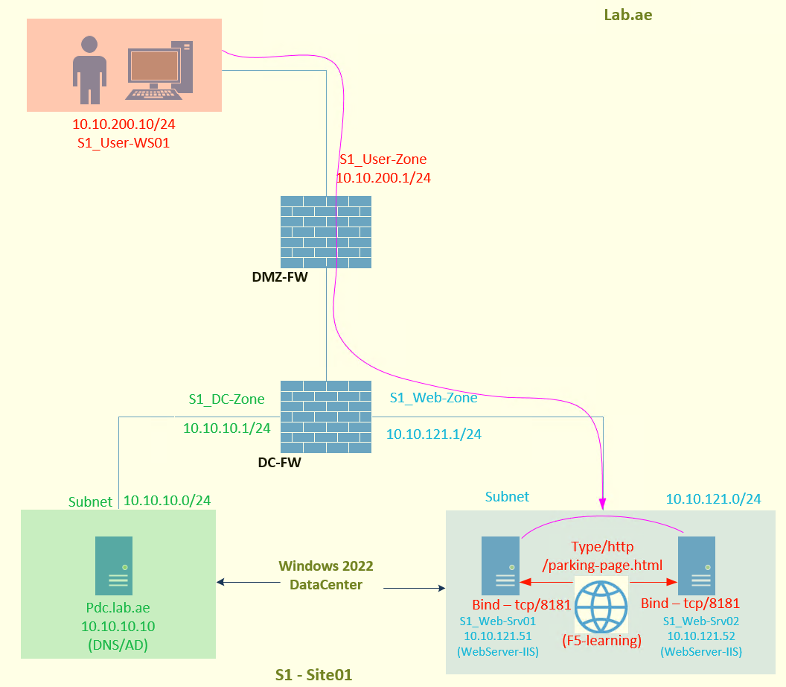
Chapter 01 - Deploy a Sample Web Application on WebSrv01 and WebSrv02
Understanding the application publishing over http
The F5 Learning application is located in E:/channel.
This application contains CSS, images, JavaScript, and HTML files.
The home page of the application is /parking-page.html.
Since this is plain text publishing, set the publishing type to HTTP.
Application Publishing: Publishing means binding the application to a TCP port on the web server. Once this is done, the web server starts listening on that port, making the application accessible to users.
HTTP - Plain Text

Slide 7
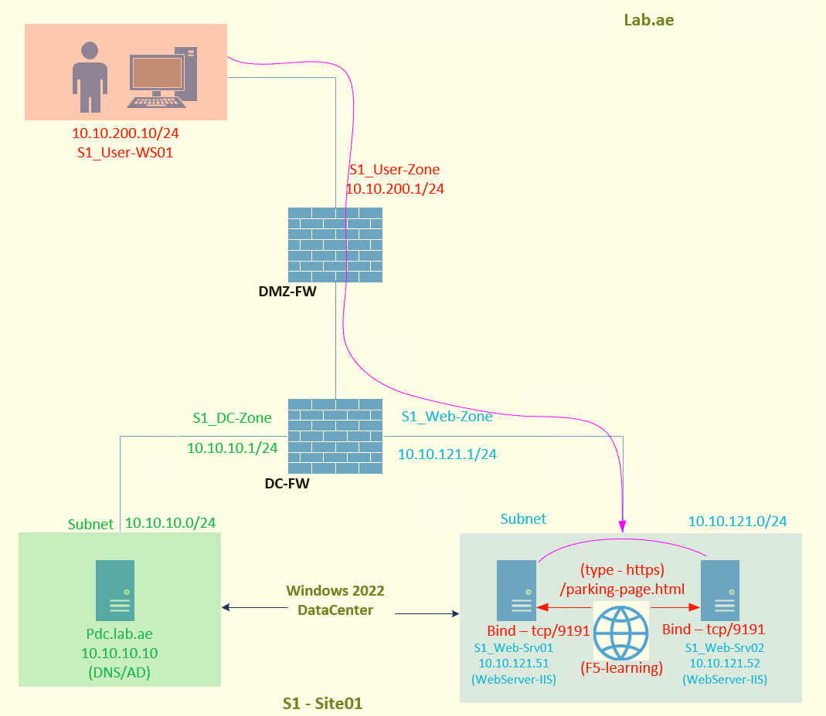
Chapter 01 - Deploy a Sample Web Application on WebSrv01 and WebSrv02
Understanding the application publishing over https
The F5 Learning application is located in E:/channel.
This application contains CSS, images, JavaScript, and HTML files.
The home page of the application is /parking-page.html.
Since this is cipher text publishing, set the publishing type to HTTPS. This requires a web server SSL certificate along with its private key.
Application Publishing: Publishing means binding the application to a TCP port on the web server. Once this is done, the web server begins listening on that port, making the application accessible to users.
HTTPS – Cipher Text

Slide 8
We have successfully Deployed and tested a sample web application on Web-Server01 and Web-Server02. This completes the Chapter01. Please continue watching Chapter02, Which is - Verify that the Web Application is accessible from the Client Machine to WebSrv01 and WebSrv02 Thank you for watching!

